Slide 1
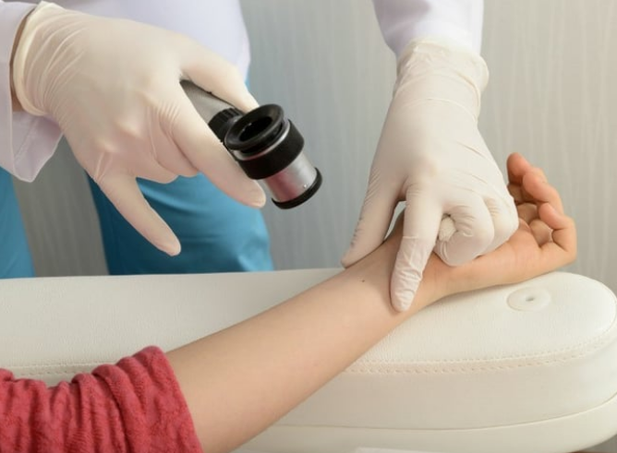
SKIN CANCER CLASSIFICATION AND DETECTION
PRESENTED BY,
SUPREETHA

Slide 2
Contents
Introduction
Objective
Technology used
Algorithm
Workflow
Methodology
User interface
Conclusion
Future enhancement

Slide 3
Introduction
Skin cancer classification and detection using deep learning project aimed at assist in the early detection and classification of skin lesions.
This project analyze images and identify different types of skin lesions.
The goal of this project is to create a reliable and accurate system that helps dermatologists and healthcare professionals diagnose skin cancer more efficiently and effectively.

Slide 4
Objectives
Accurate Classification: Develop machine learning models capable of accurately classifying dermatological images into different categories such as benign, malignant, or specific types of skin cancer.
Early Detection: Enable early detection of skin cancer by creating algorithms that can identify subtle signs of malignancy in skin lesions, potentially leading to timely medical intervention and improved patient outcomes.
Real-Time Detection: Implement algorithms capable of real-time detection and classification of skin lesions, allowing for quick and efficient diagnosis during clinical examinations or through mobile applications.

Slide 5
Cont..
Accessible Healthcare: Improve access to skin cancer diagnosis, especially in underserved areas, by leveraging machine learning technologies to assist healthcare providers in triaging and diagnosing skin lesions accurately.
Scalability and Generalization: Develop models that are scalable and generalize well across diverse populations and skin types, ensuring their effectiveness in various clinical settings and demographics.

Slide 6
Technology Used
HARDWARE REQUIREMENTS
RAM: 8 GB or higher
Storage: 256 GB SSD or higher
Network: Ethernet/Wi-Fi for internet connectivity
Display: 15-inch monitor or larger
Processor: Intel Core i5 or equivalent
LANGUAGES USED
Front-end: HTML, CSS, Javascript
Back-end: Python, Flask

Slide 7
Front-End
HTML(Hyper Text Mark Up Language)
Used for structuring the web pages and forming the layout of the user interface.
CSS(Cascading Style Sheet)
Applied for styling the web pages, making the interface visually appealing and responsive.
JavaScript
Utilized for adding interactivity to the web pages, such as handling user inputs and dynamic content updates.

Slide 8
Back-End
Python
The programming language used to develop the core logic of the application.
Handles image processing tasks, such as loading, resizing, and preprocessing images for classification.
Flak
A lightweight and versatile web framework for Python.
Manages routes, such as the home page and the prediction endpoint, ensuring smooth navigation and user experience.
Facilitates communication between the frontend and backend

Slide 9
Algorithm
Convolutional Neural Network(cnn)
CNNs automatically learn important features from images, so there's no need to manually identify and extract these features.
CNNs consist of multiple layers, including convolutional layers for feature extraction, pooling layers for dimensionality reduction, and fully connected layers for final classification.
CNNs achieve high accuracy in image-related tasks by capturing complex patterns and hierarchical structures in the data, making them suitable for skin disease classification in this project.

Slide 10
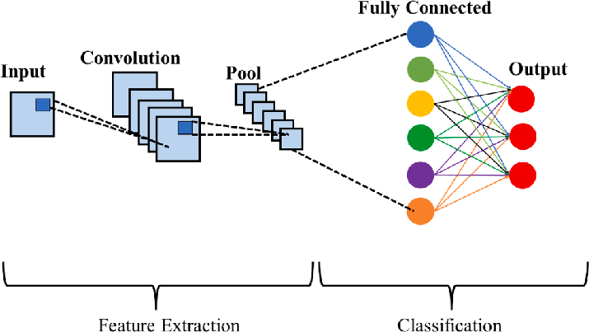
Algorithm

Slide 11
Cont…
Convolutional Layer :The Convolutional Layer applies multiple filters to detect features like edges and textures, producing feature maps that highlight important details.
Pooling Layer :The Pooling Layer reduces the feature map's dimensionality to decrease computational load.
Fully Connected Layer : This classifies the input by combining the extracted features and producing the final classification probabilities.

Slide 12
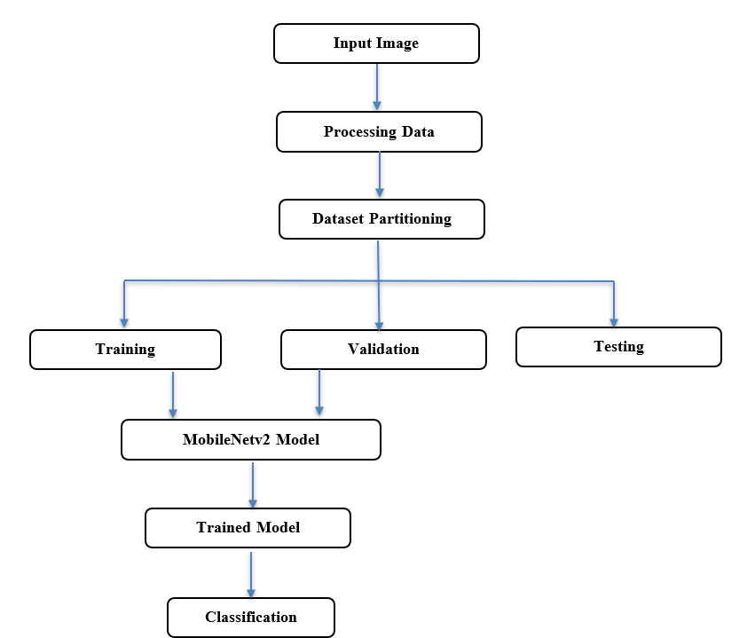
Work Flow

Slide 13
Methodology
Data Collection:
Gathered skin cancer images from reputable sources.
Labeled images into various categories .
Data Preprocessing:
Resized images to 224x224 pixels.
data augmentation (e.g., rotation, flipping).

Slide 14
Cont..
Model Training:
Used MobileNetV2 for feature extraction.
Added custom dense layers for classification.
Model Evaluation:
Evaluated model using accuracy, confusion matrix, and classification report.

Slide 15
Cont..
Classification
The trained CNN model classified skin lesions into various categories with high accuracy.
Features extracted during training were used to differentiate between benign and malignant lesions.
The model also identified specific types of skin cancer.

Slide 16
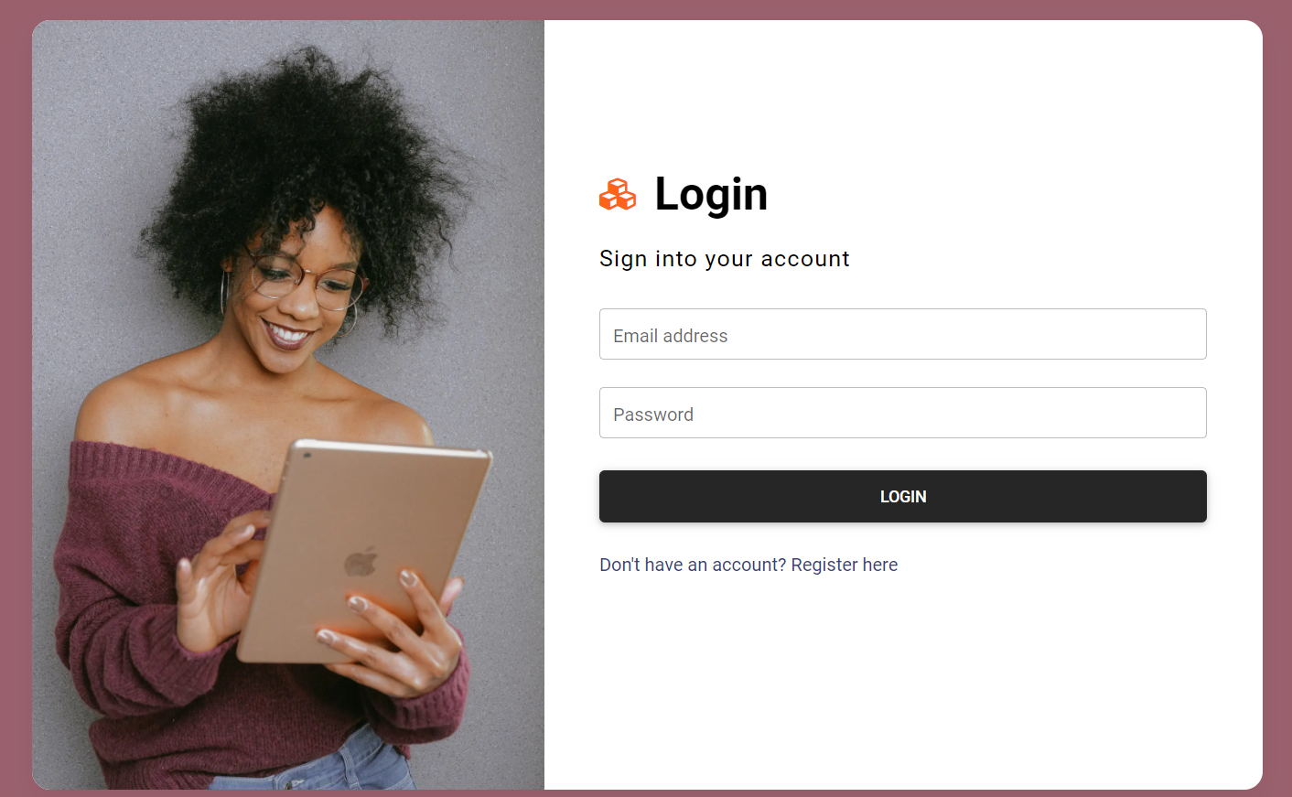
User Interface
Login Page:
The login page secures system access by prompting users to enter their username and password, ensuring only authorized personnel can access sensitive patient data.

Slide 17
User Interface
Registration Page:
The login page secures system access by prompting users to enter their username and password, ensuring only authorized personnel can access sensitive patient data.

Slide 18
User Interface
Dashboard:
Home: Guides users through the diagnostic process with upload instructions.
About Us: Explains the system's purpose, technology, team, and healthcare goals.
News: Shares updates and research on skin cancer diagnosis and treatment.
Contact: Offers contact information and support resources.
Identify Skin Disease: Lets users upload skin images for diagnostic predictions and reports.

Slide 19

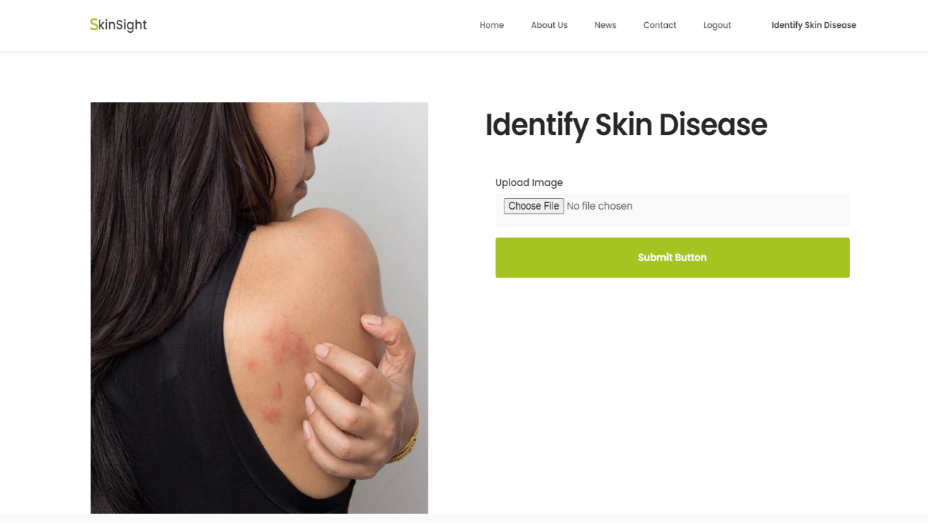
Cont...

Slide 20
Cont...
Image of the Skin Lesion
The uploaded image of the skin lesion is prominently displayed on the left side of the page.
Predicted Result
The page shows the predicted result of the analysis, indicating the type of skin disease.
Example: "Predicted Result: Melanoma"
Description of the Disease
A brief description of the predicted skin disease is provided.
Example: "Melanoma is a type of skin cancer that can spread to other organs."

Slide 21
Cont...
Confidence Score
The confidence score of the prediction is displayed, reflecting the model's certainty.
Example: "Confidence: 0.99999785"
Cancerous Status
Information on whether the lesion is classified as cancerous or not.
Example: "Cancerous: Yes"
Treatment Options
A section detailing possible treatment options for the identified skin disease.
Example: Treatments include surgery, radiation, medications, and in some cases chemotherapy.

Slide 22
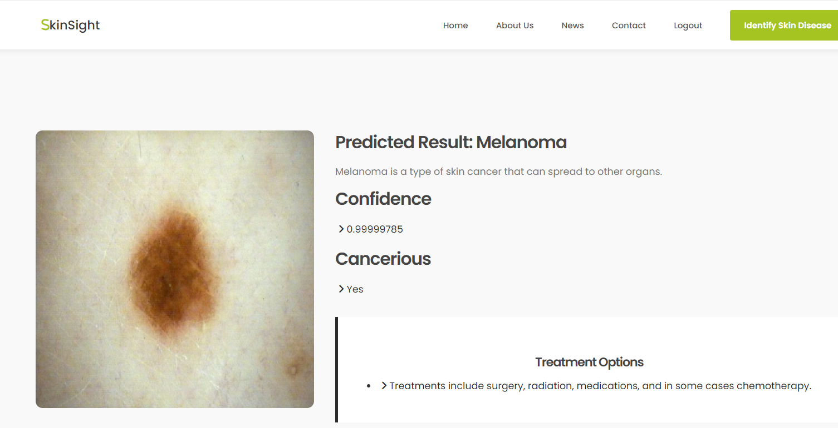
Cont...

Slide 23
Conclusion
our project uses advanced technology like Convolutional Neural Networks (CNNs) to classify skin images accurately. This improves early detection of skin conditions.
This approach not only facilitates early detection but also holds promise for enhancing patient care by providing timely and reliable diagnostic insights.

Slide 24
Future Enhancement
Expanded dataset to include diverse skin types, lesion types, and demographic details.
Integration of multimodal data such as patient medical history, genetic information, and clinical notes.
Utilization of advanced deep learning techniques like transfer learning and ensemble methods.
Development of a user-friendly mobile application for real-time image capture and analysis.
Enhanced user interface and accessibility for broader usage, especially in underserved areas.

Slide 25
THANK YOU

